Slide 1
Lutheran Theological Seminary in Tshwane
Report 2012

Slide 2
Goal
Training pastors
Equipping workers of mercy
Serving God’s people in the Lutheran Church and its mission throughout Africa

Slide 3
Members
Free Evangelical Lutheran Synod in South Africa (FELSiSA)
Lutheran Church in Southern Africa (LCSA)
Mission of Lutheran Churches (MLC)

Slide 4
Members of lts
MLC: Rev. C. Weber (Chairperson) Rev. P.C. Weber
FELSiSA: Bishop Reinstorf Mr. Manfred Johannes
LCSA: Bishop Weber Dean Vilakazi Dean Danisa

Slide 5
LTS Board of directors
Dr. Gunter Rencken (Chairman)
Bishop Weber (Rector)
Ruben Dlamini
Rev. John Nkambule
Rev. Matthias Albers
Michael Grosse
Berno Niebuhr

Slide 6
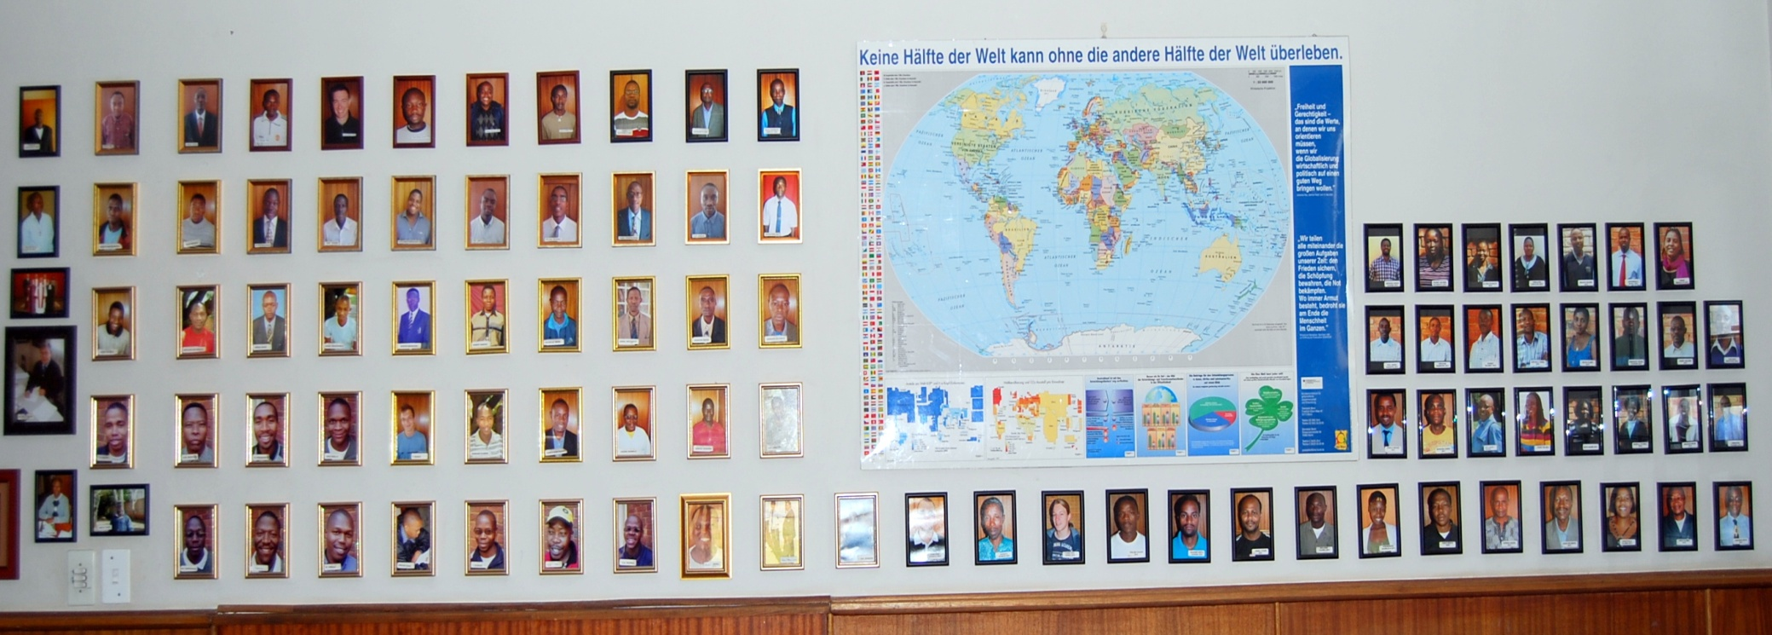
More than 100 Students since 2001

Slide 7
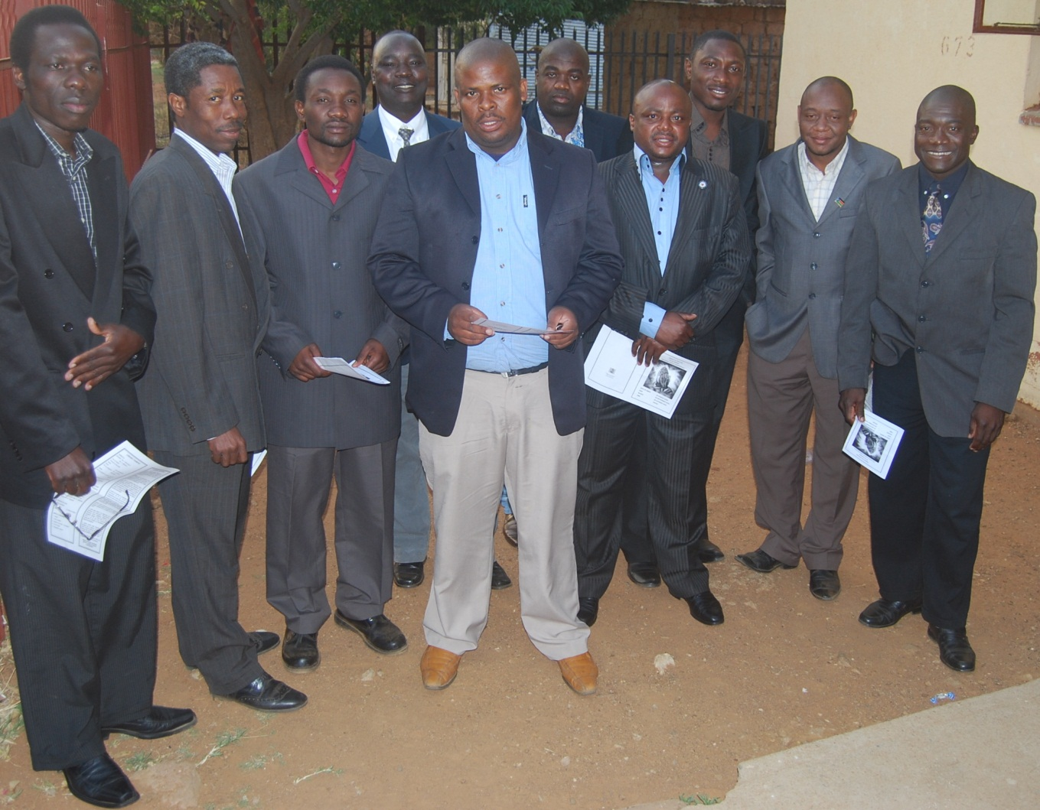
Botswana, Uganda, kenya, Sudan, Liberia, Nigeria, Ethiopia, Zambia …

Slide 8
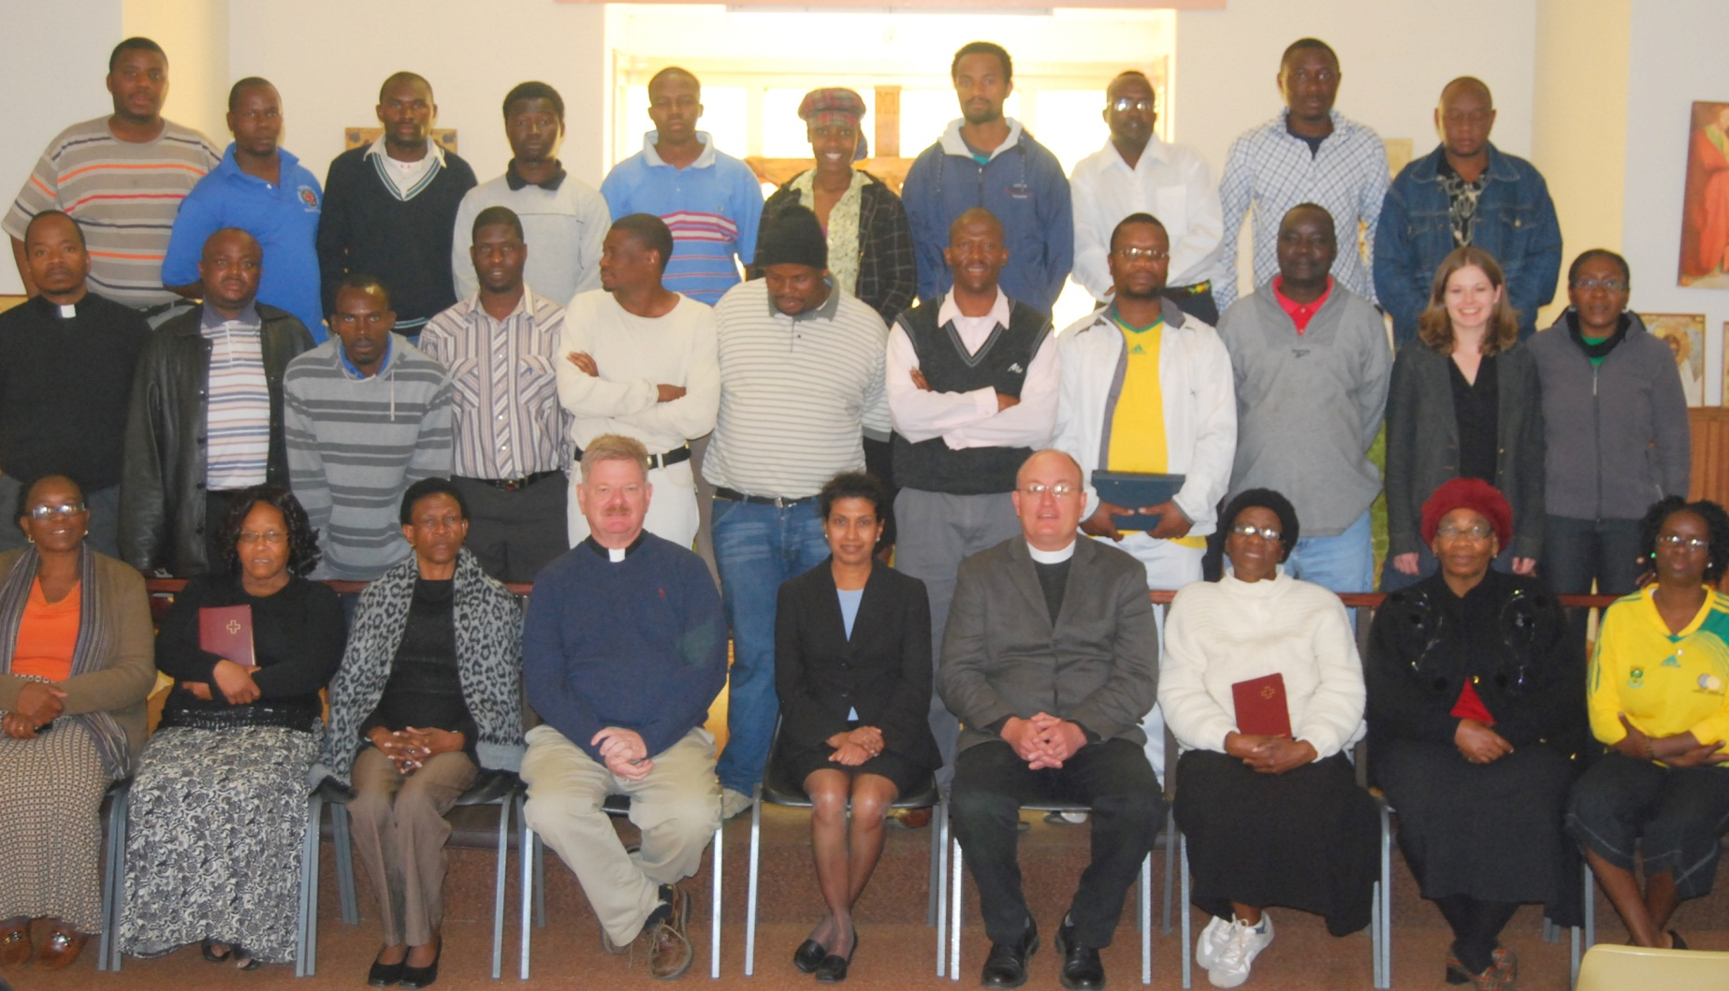
Seminarians

Slide 9
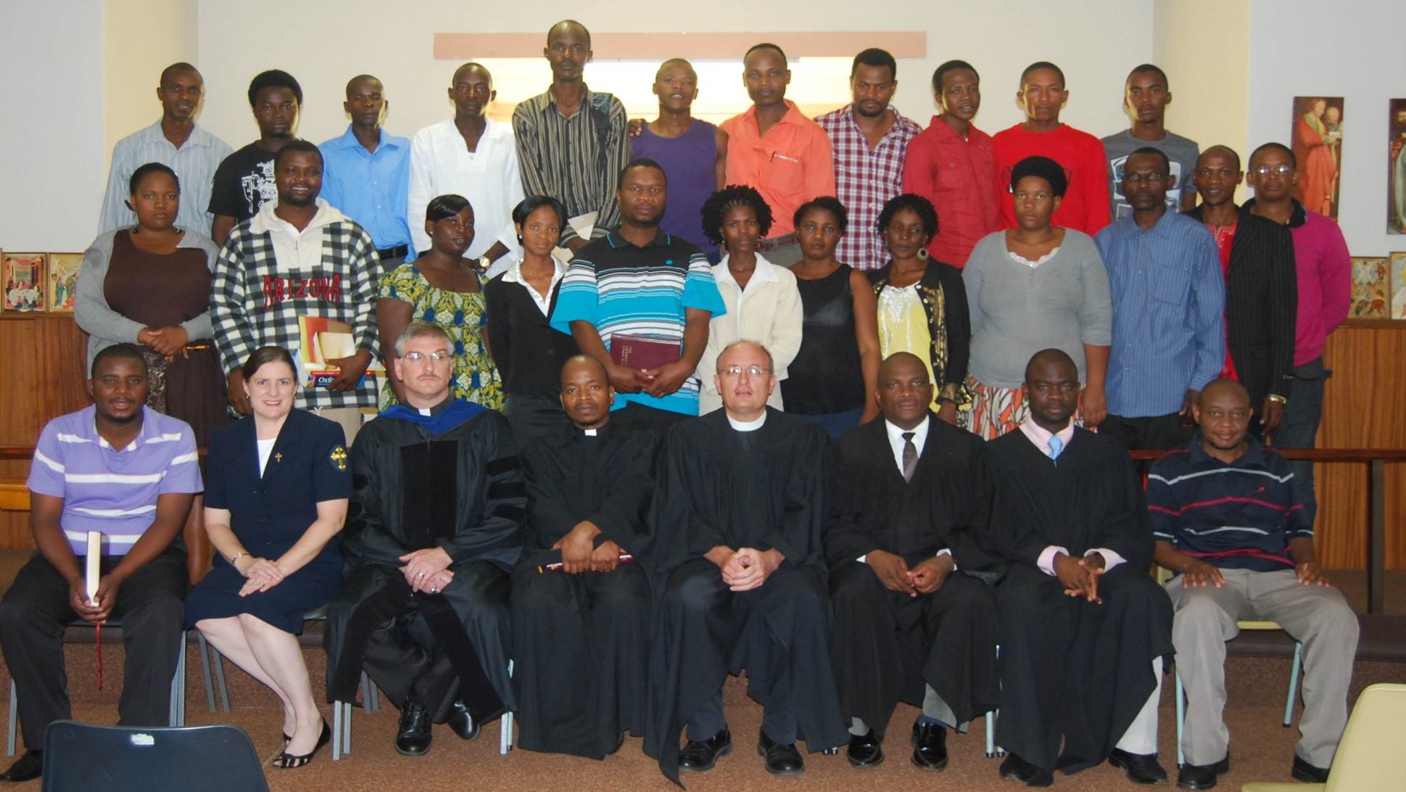
Seminarians in 2012

Slide 10
Programs & Courses
Bridging (LTS): 2 yrs
Main (BTh at UP/LTS): 3 yrs
Post-graduate (UP): 2 yrs
Works of mercy (LTS): 2 yrs

Slide 11
Objectives per year: 90 students
20 students in Bridging Course
30 students in the Bachelor of Theology program
20 students in the post-graduate program
20 students in the deaconess program

Slide 12
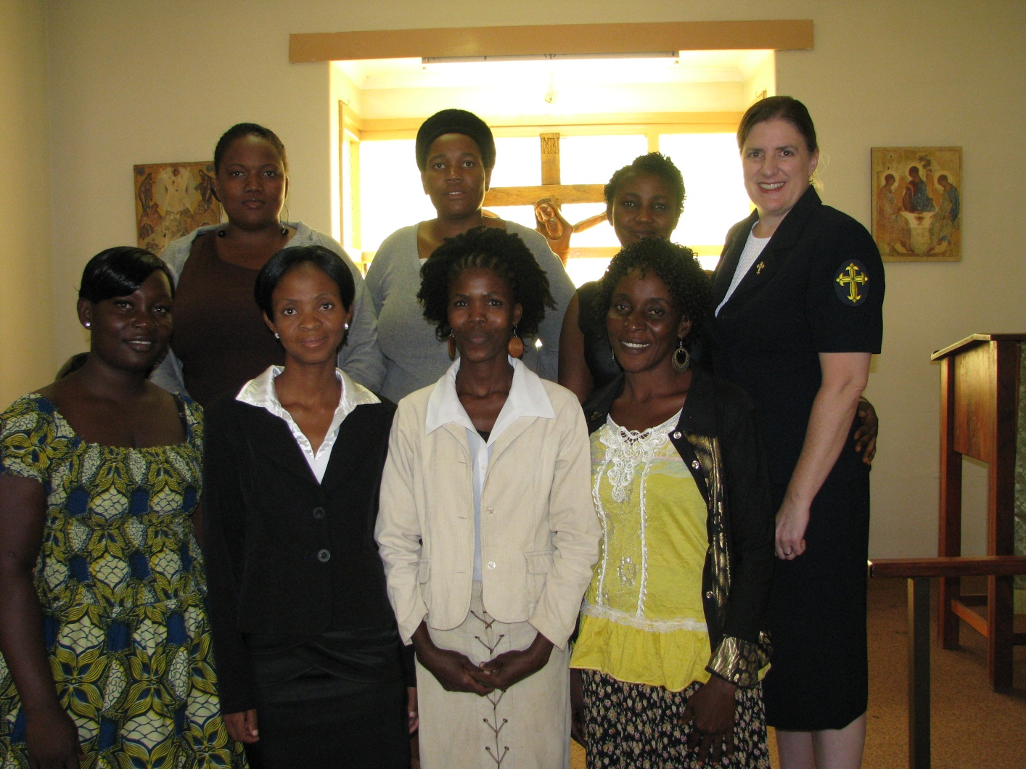
With deaconess Rockrohr 2012

Slide 13
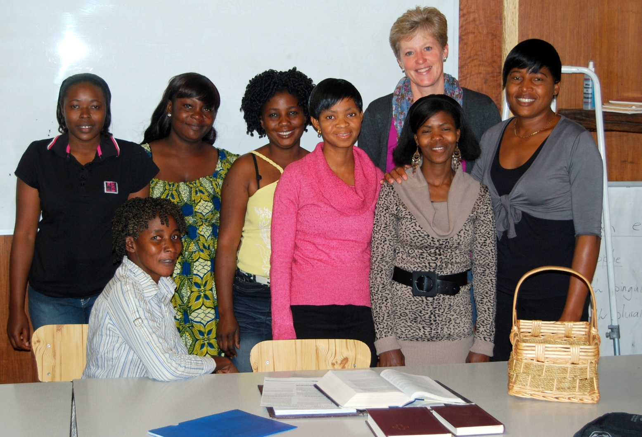
With Karin niebuhr 2012

Slide 14
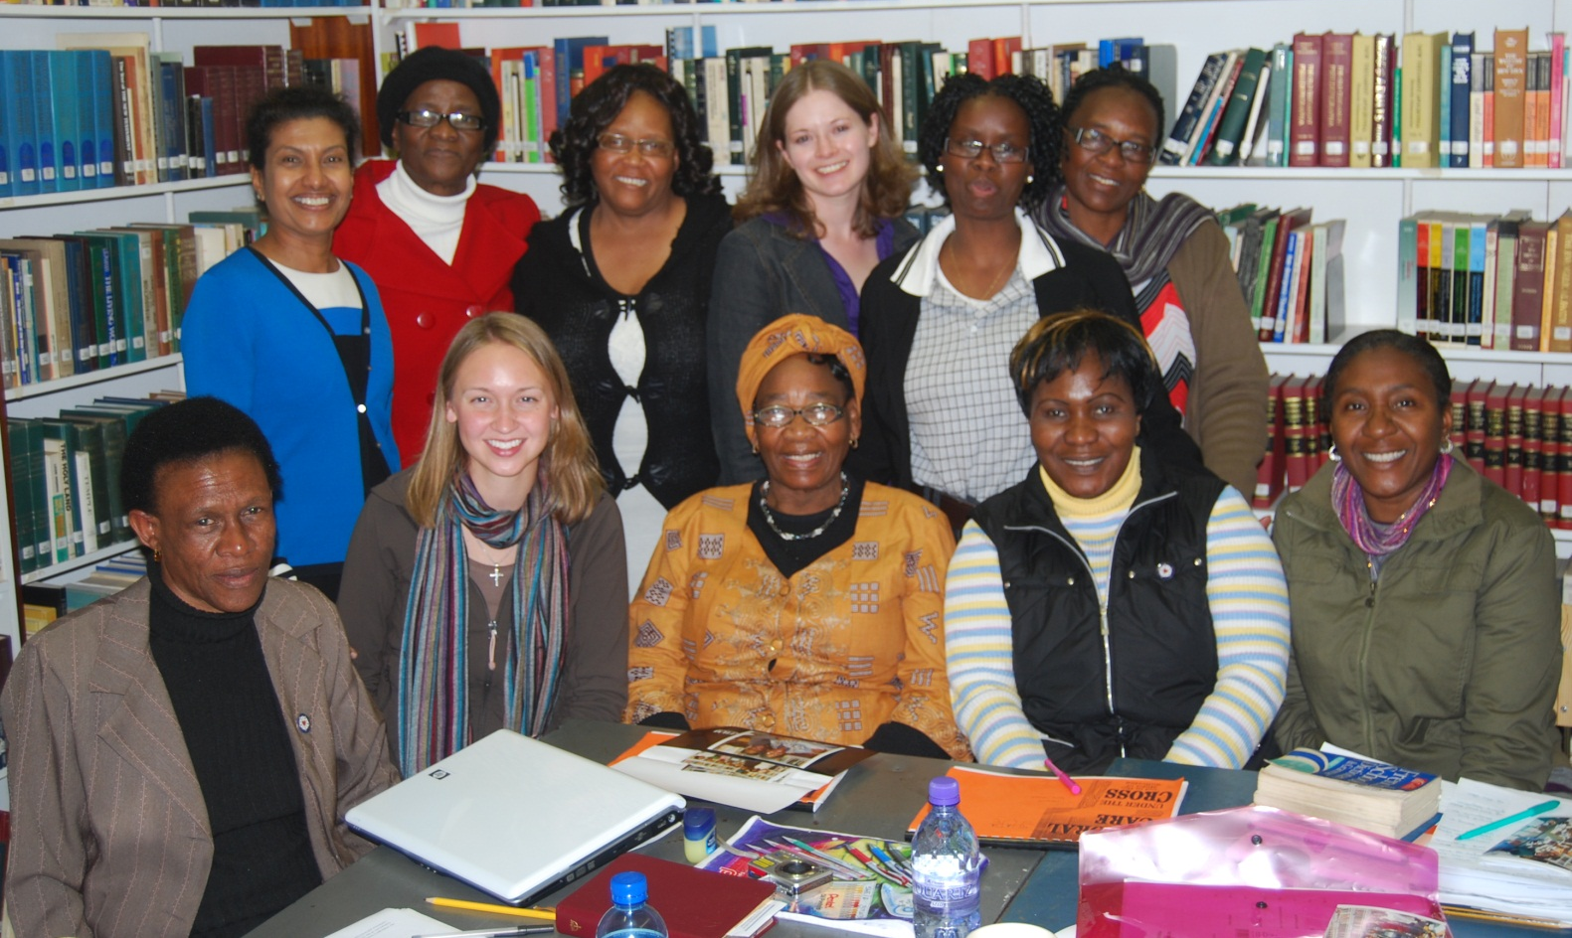
With Deaconess Rao 2011

Slide 15
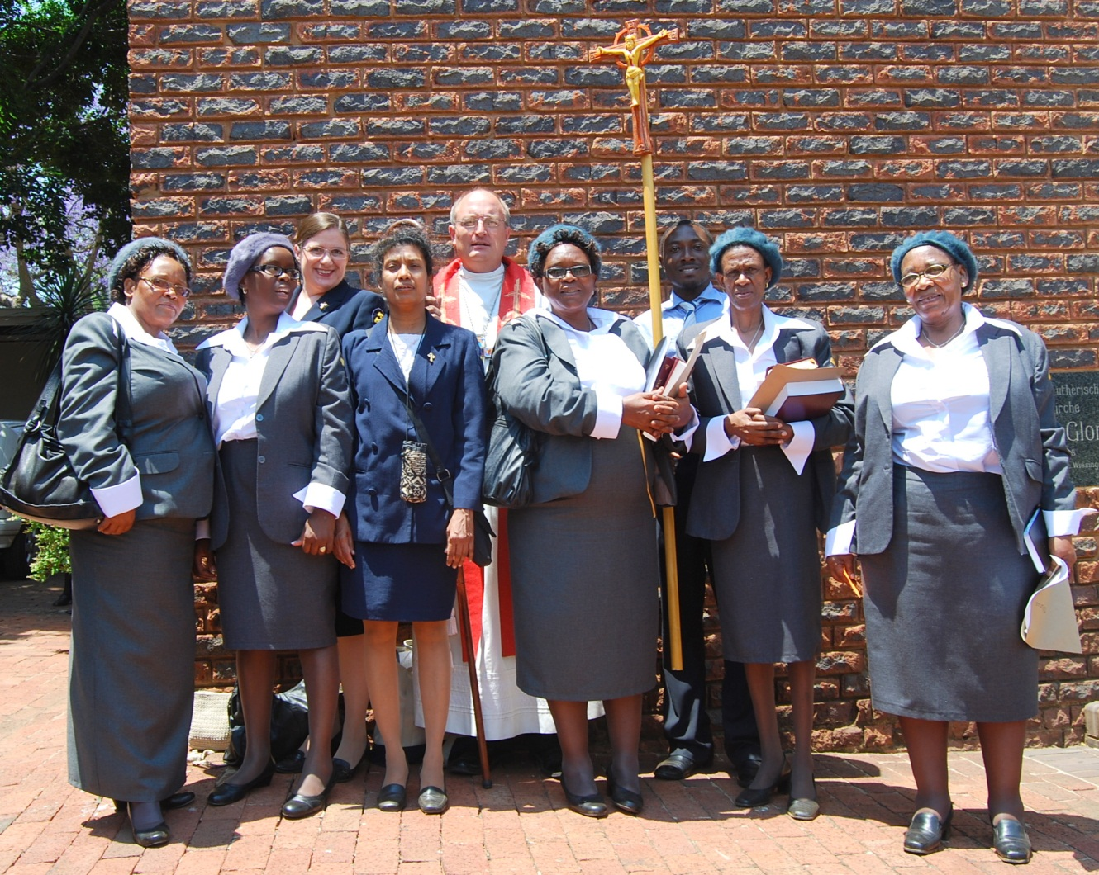
First Graduation of deaconesses

Slide 16
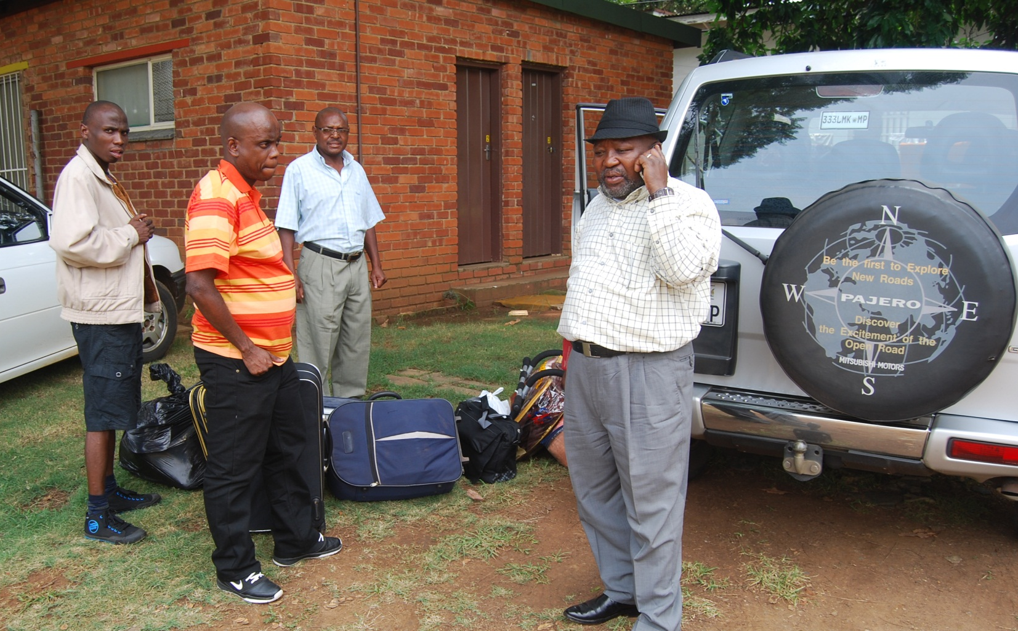
Just around the corner from St. Peter’s LC in Middleburg

Slide 17
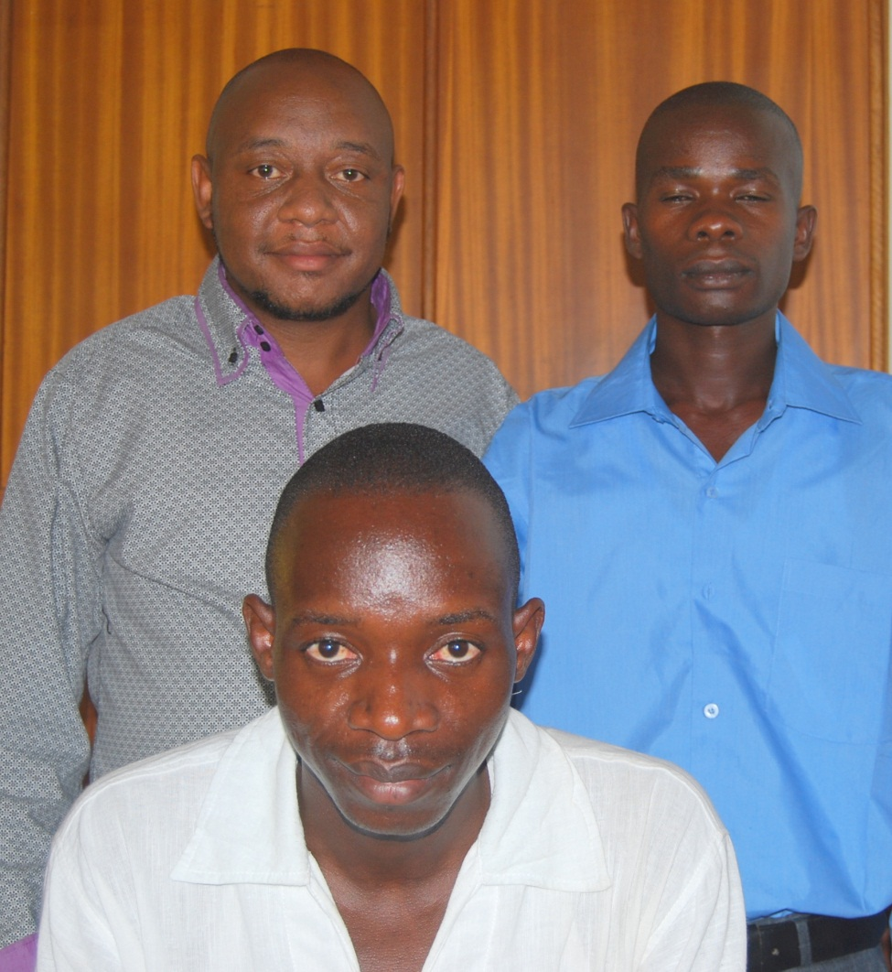
All the way from S.sudan

Slide 18
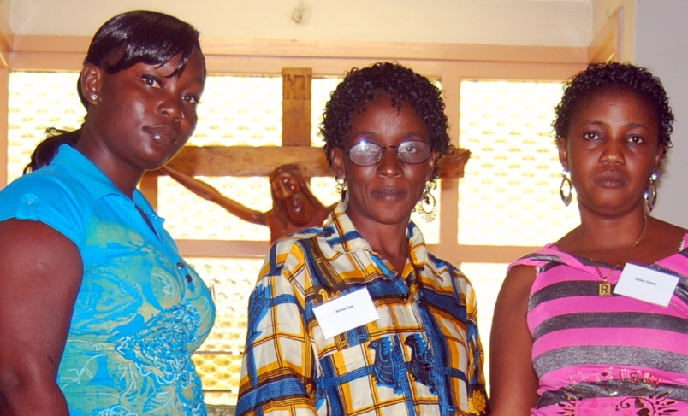
Even further from liberia

Slide 19
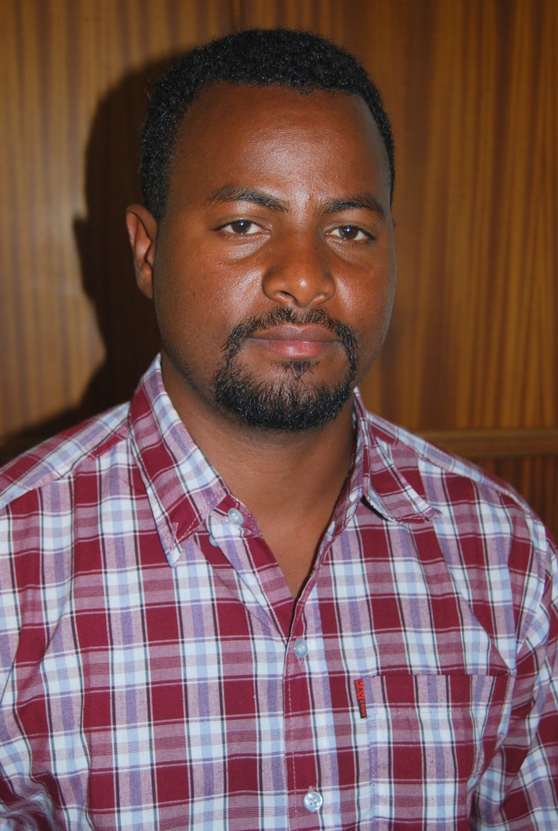
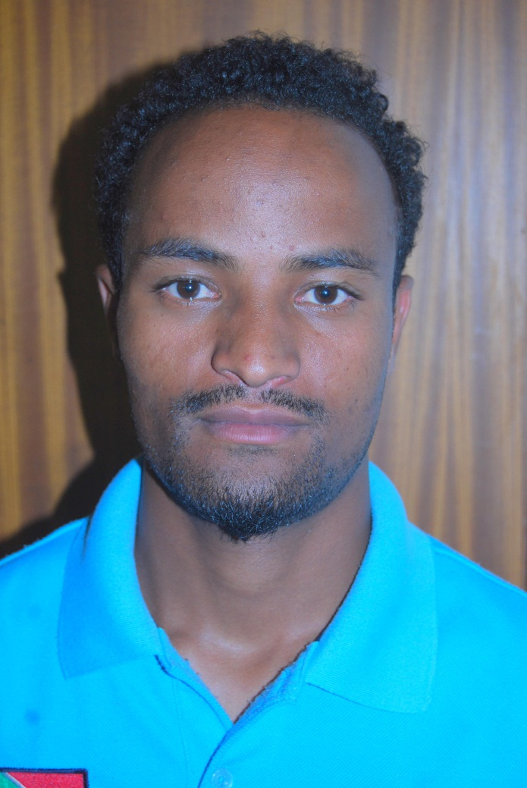
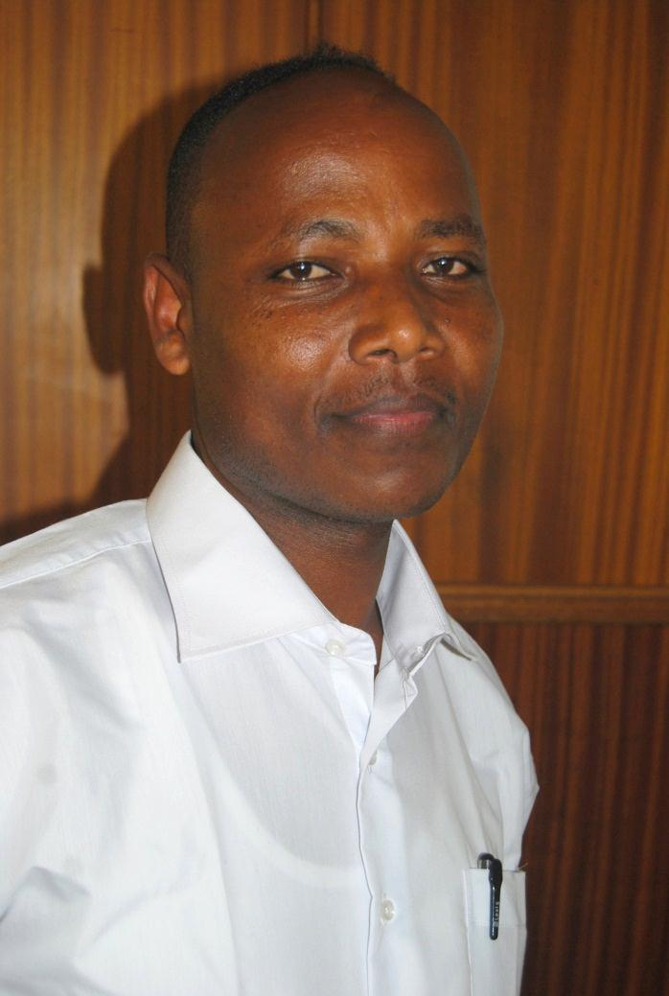
Brothers and friends from Mekane Yesus Lutheran Church, Ethiopia

Slide 20
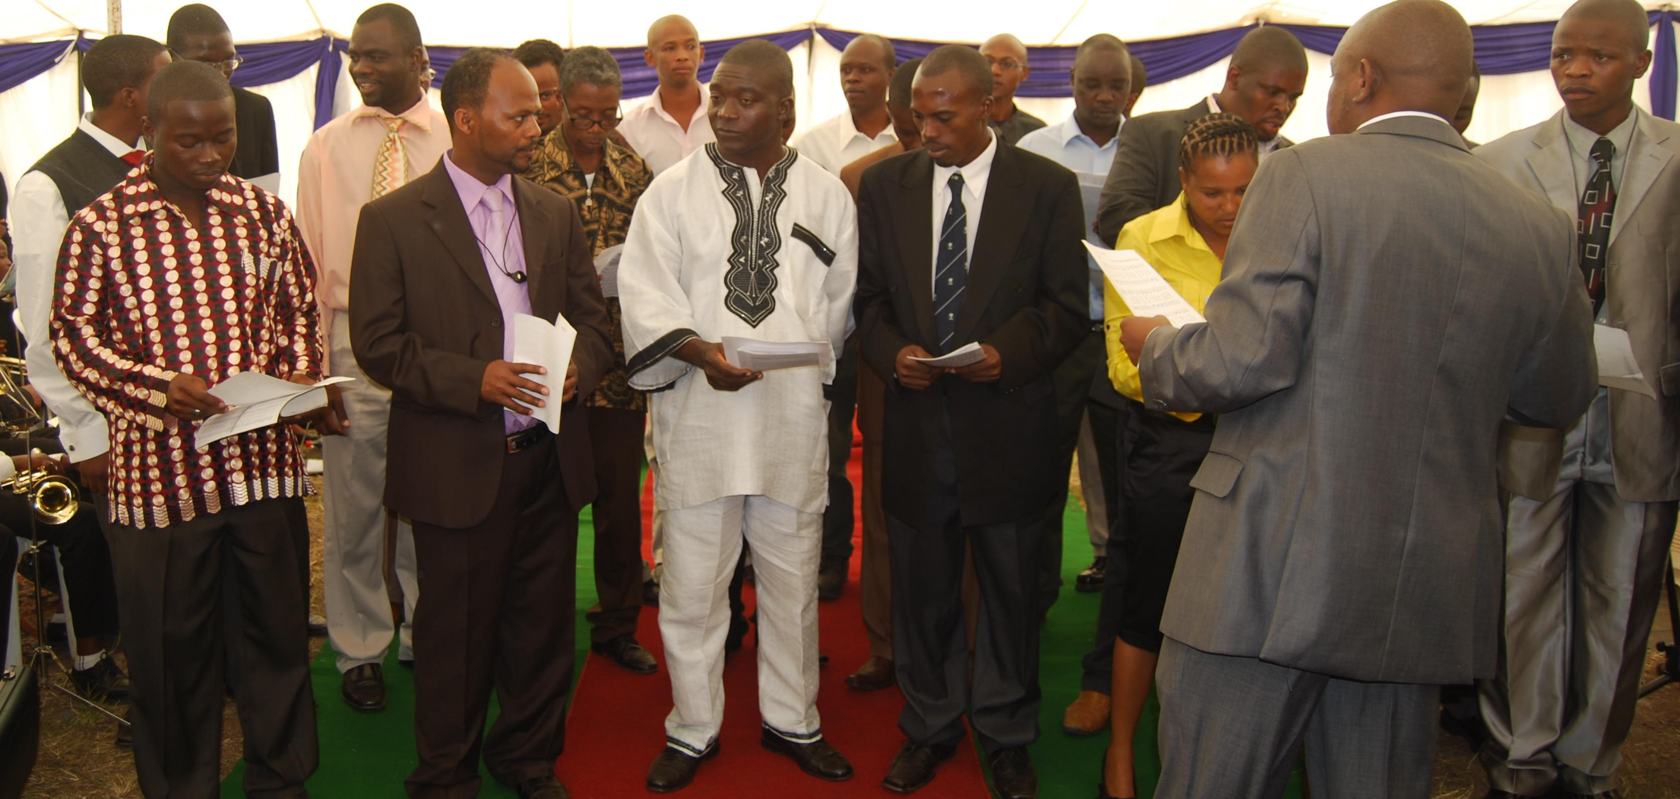
Students in Action 2010

Slide 21
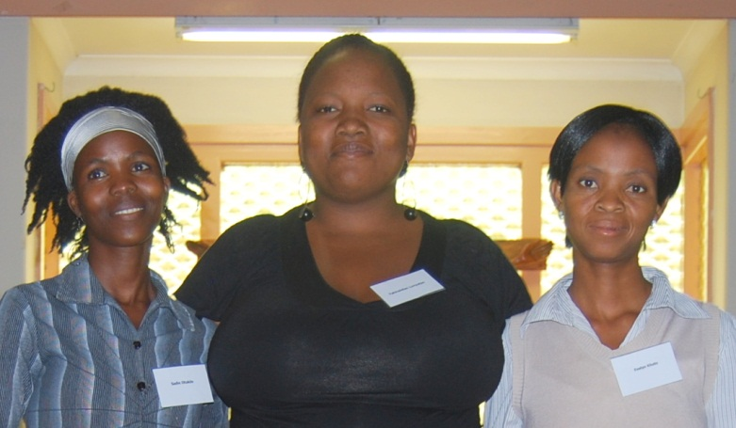
Botswana: Good Neighbours

Slide 22
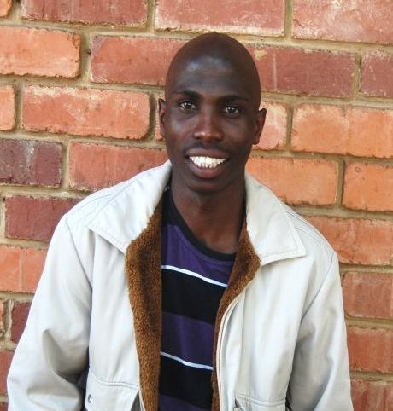
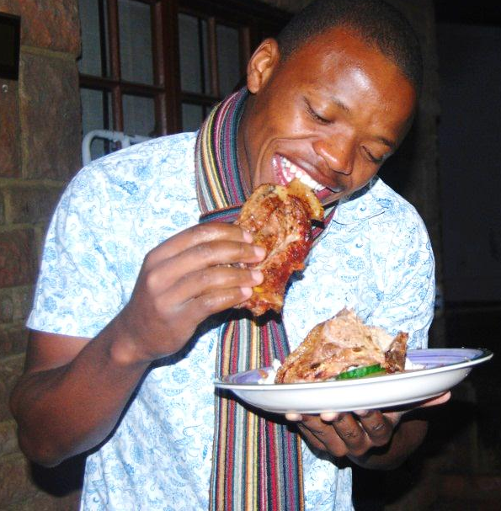
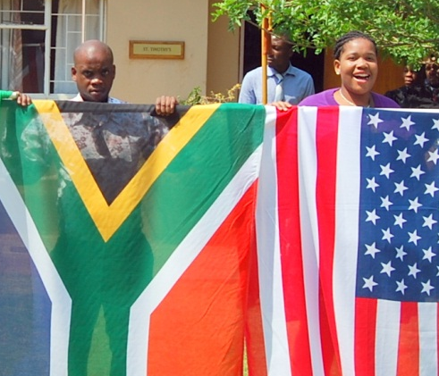
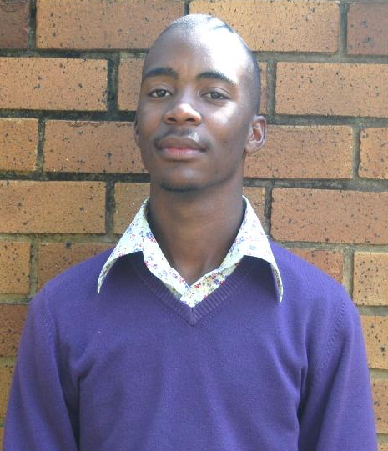
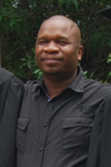
South Africans

Slide 23
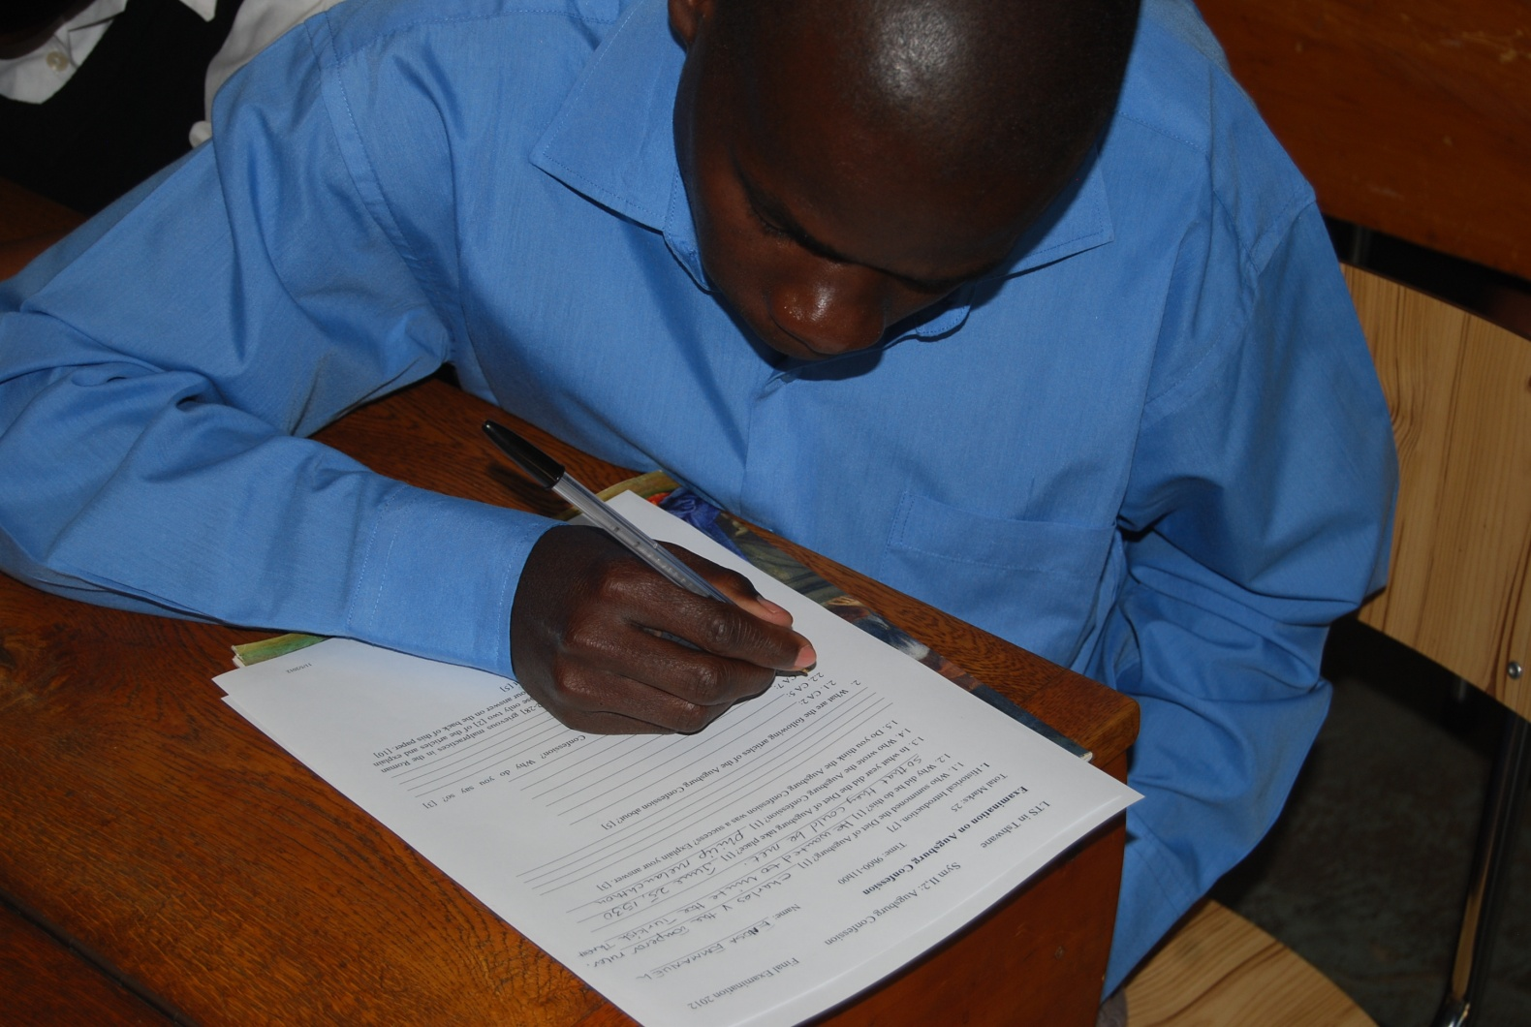
Examination

Slide 24
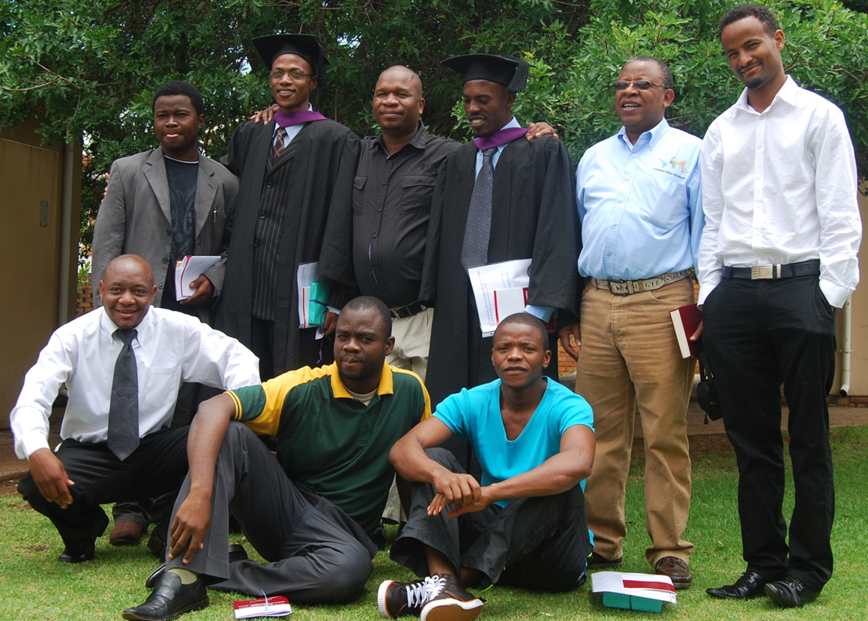
Graduation 2011

Slide 25
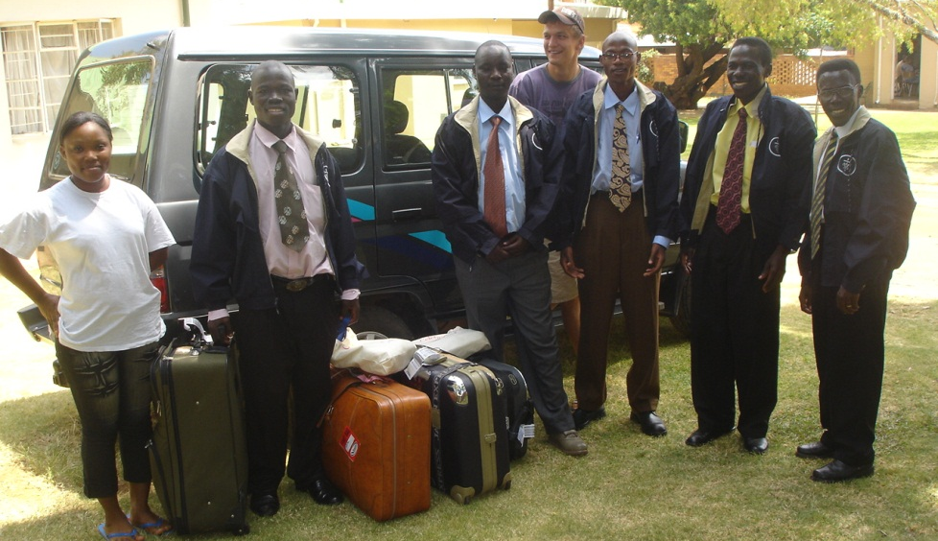
Returning home

Slide 26
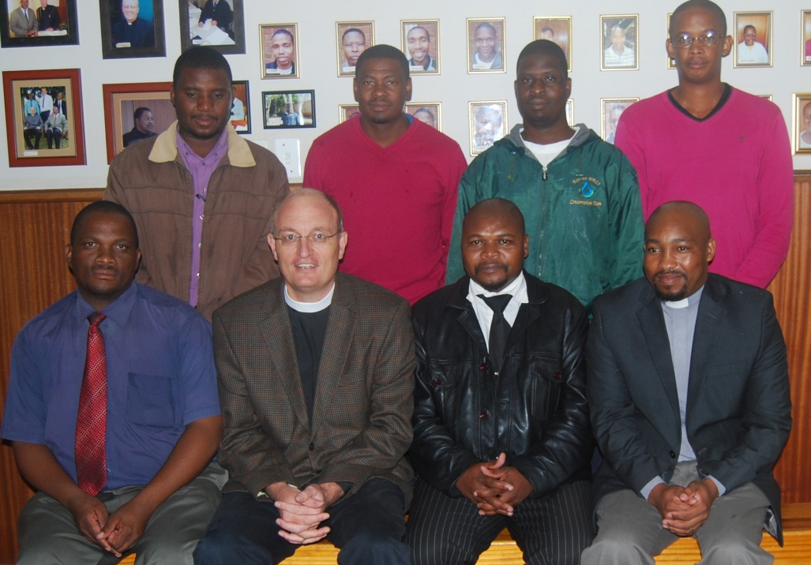
Ordination course: MARCH 2012
Notes:
Dean Vilakazi was not present

Slide 27
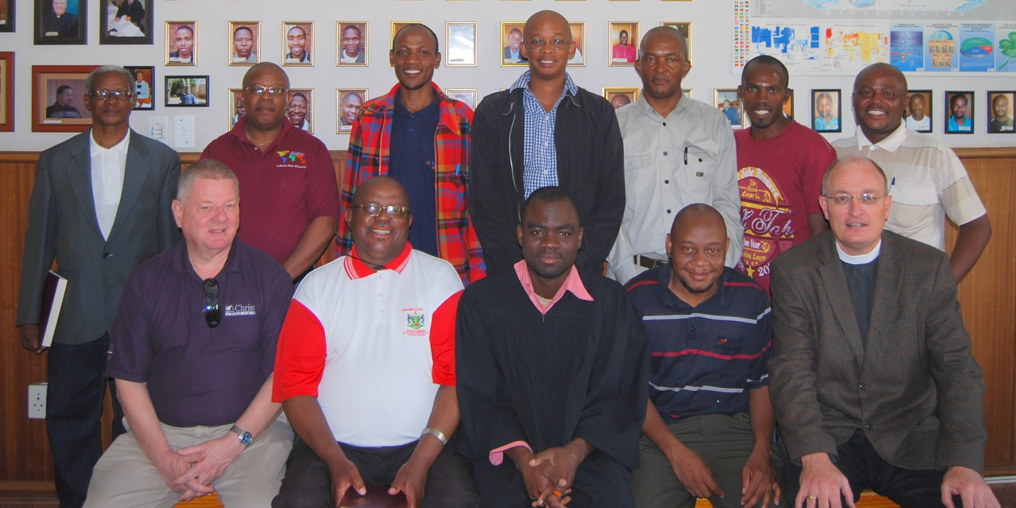
Ordination course November 2012
Notes:
Dean Vilakazi was not present

Slide 28
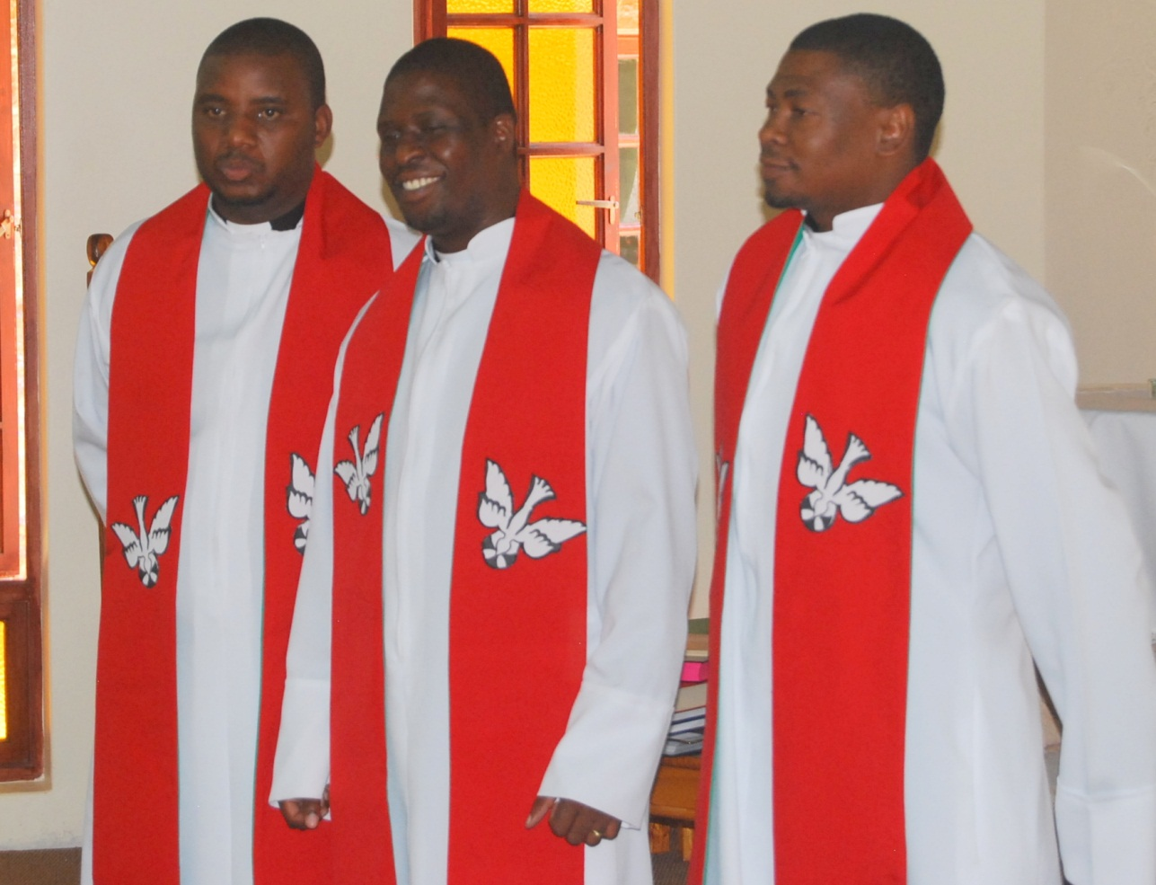
Ordination March 2012

Slide 29
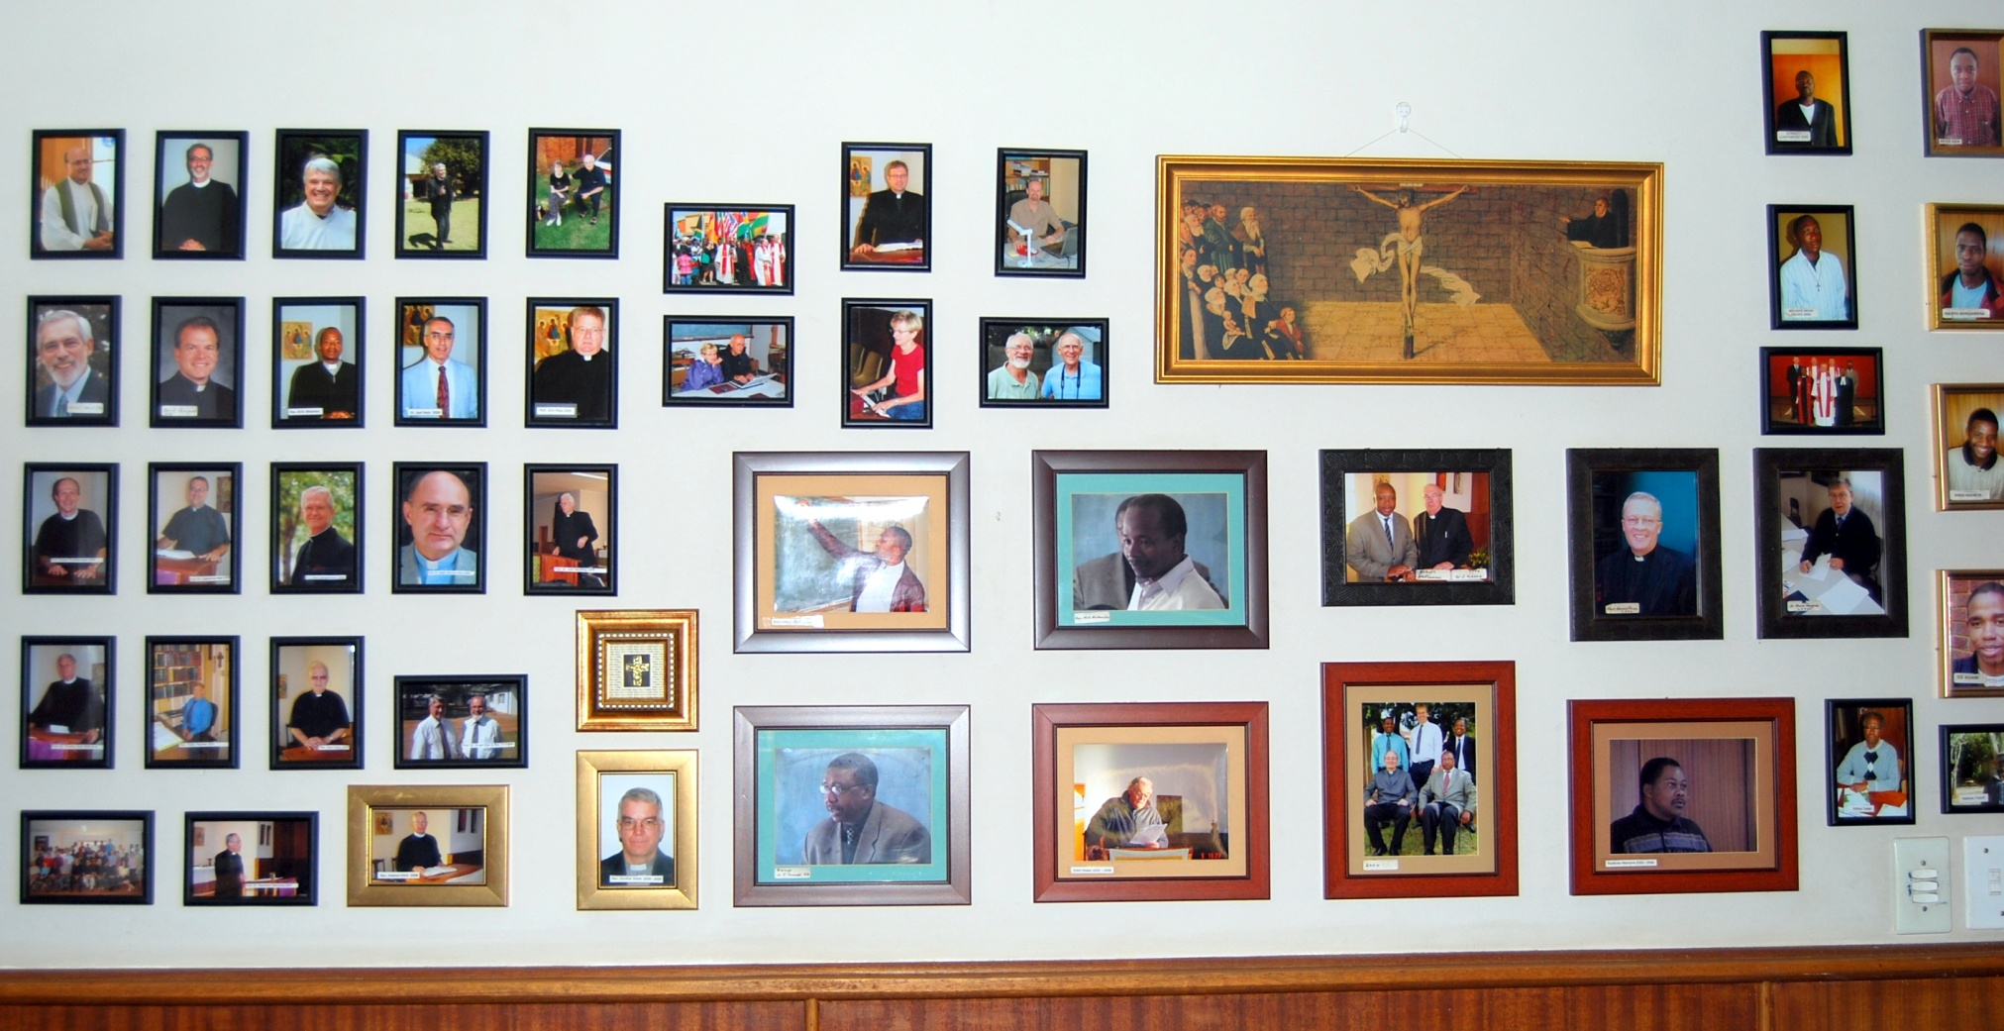
Teachers at LTS

Slide 30
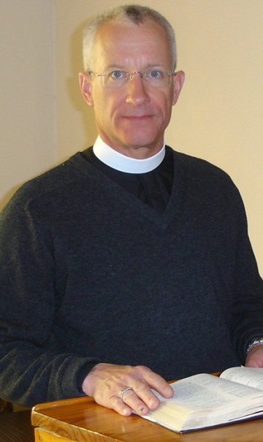
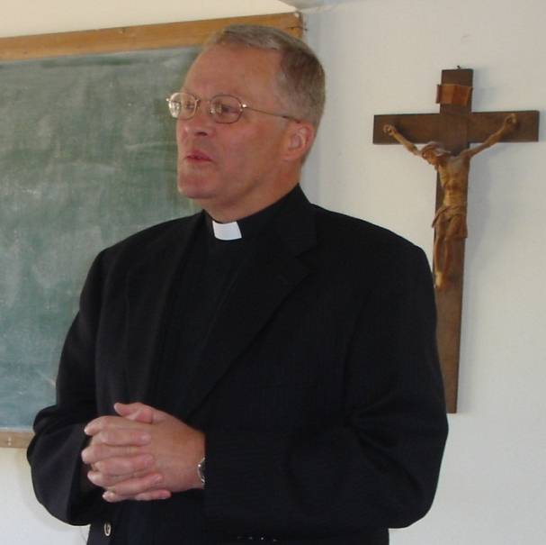
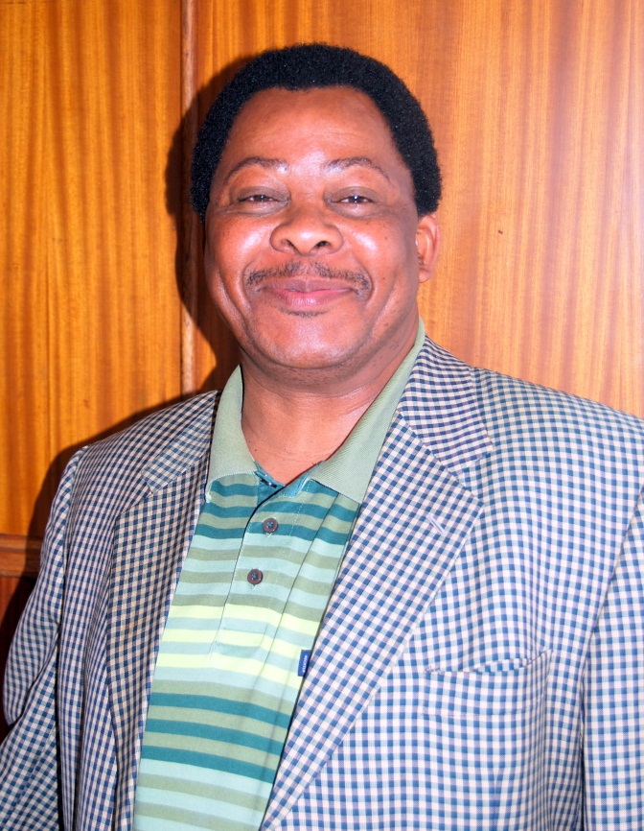
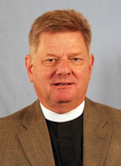
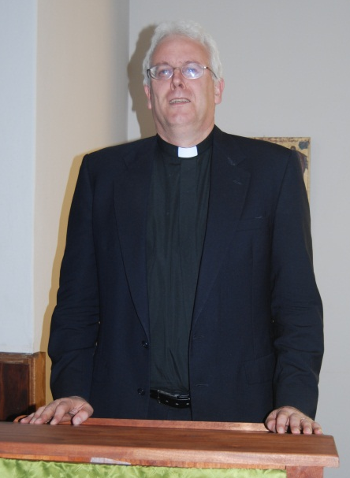
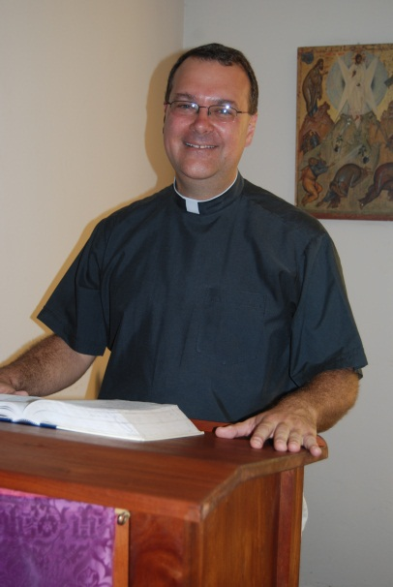
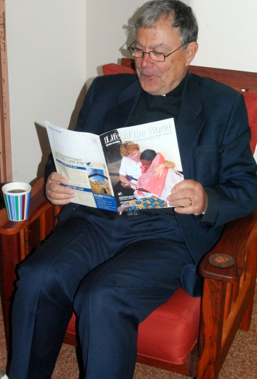
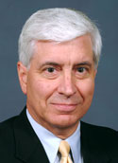
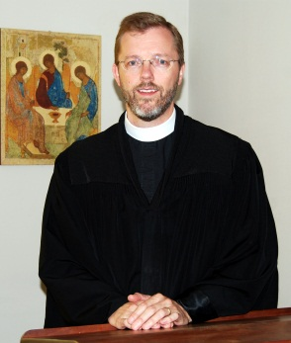
close up

Slide 31
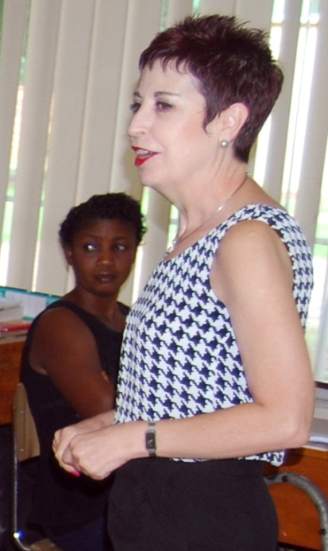
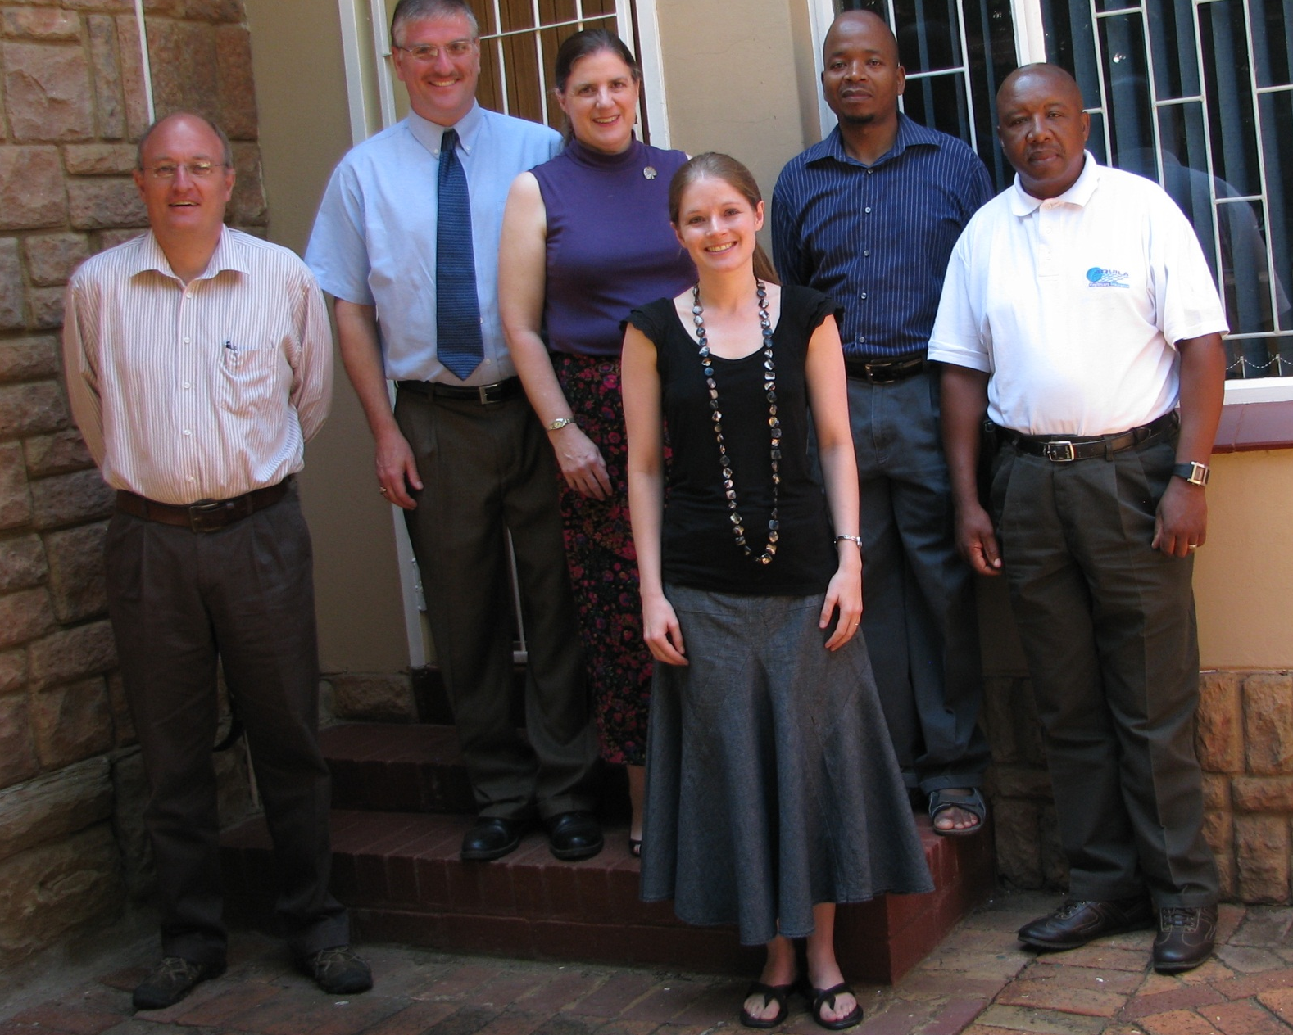
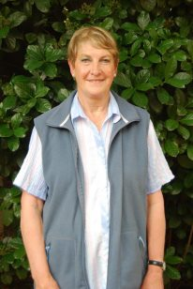
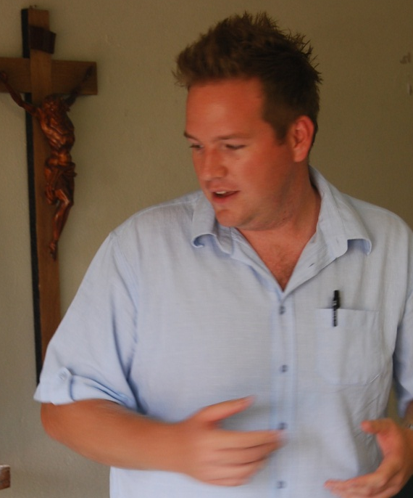
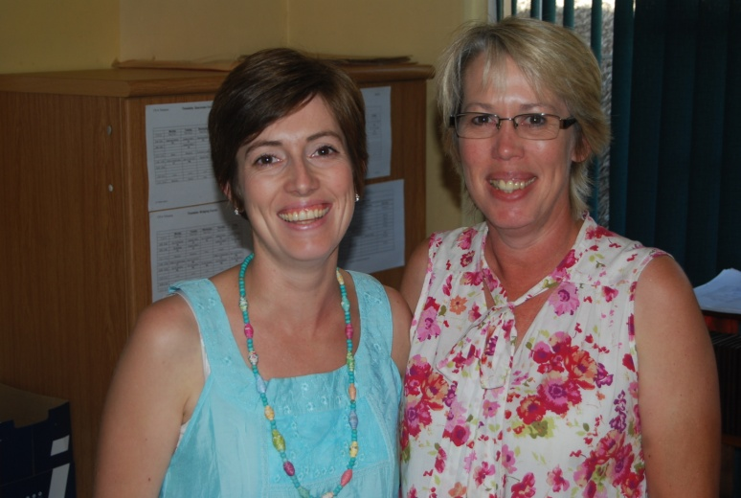
Staff 2012

Slide 32
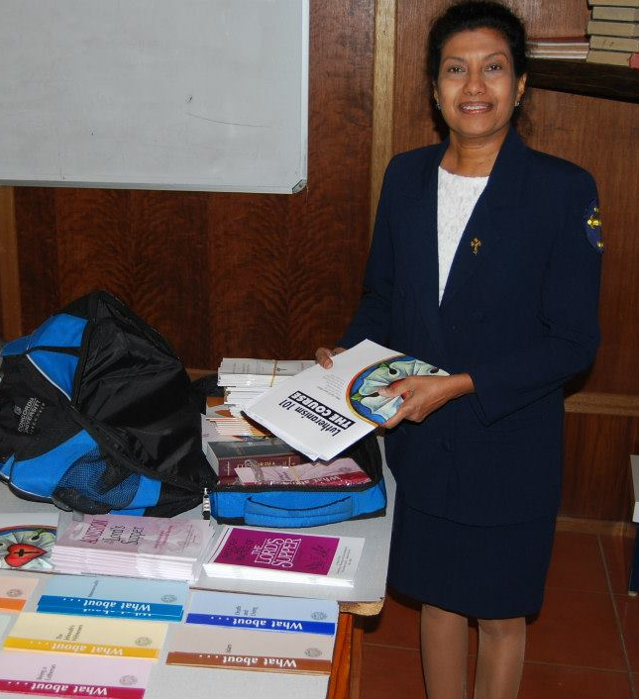
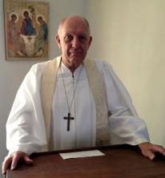
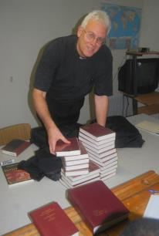
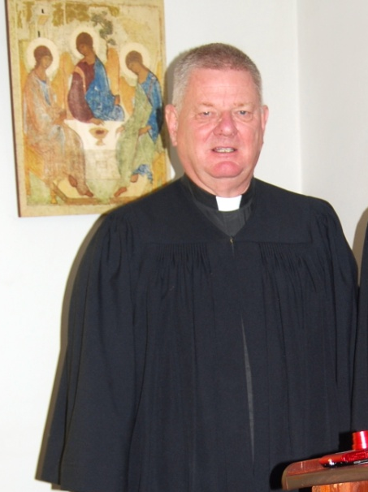
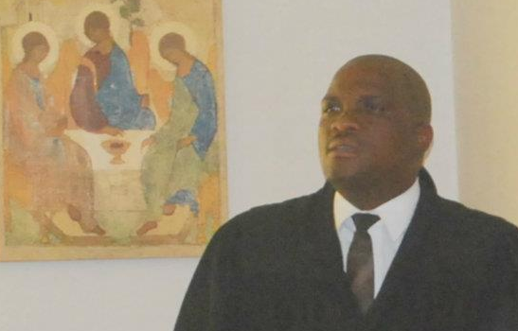
Guest lecturers

Slide 33
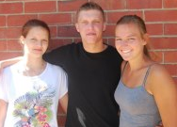
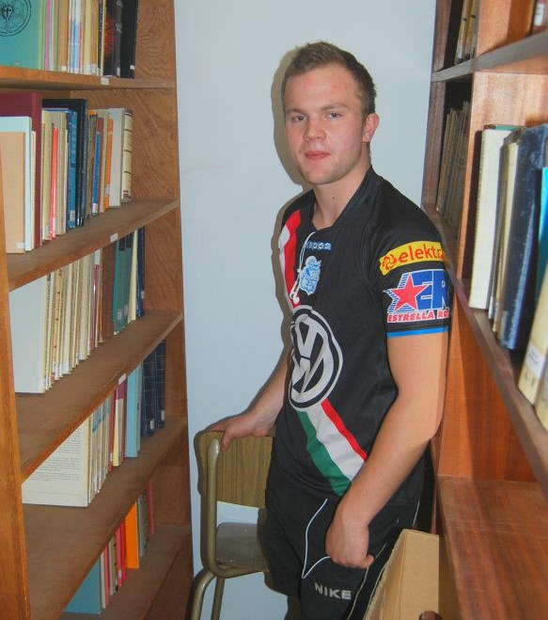
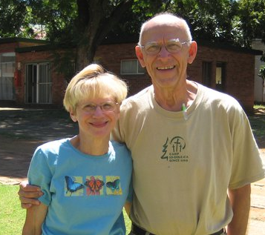

Hoffmeier, Dierks & Studer

Slide 34

Board of Directors

Slide 35

ILC Seminaries conference Leriba

Slide 36

Pastor’s Convention 2010

Slide 37

Facility: Hopes in 2008

Slide 38

Hokaai 1: St.Marys or the Good samaritan?

Slide 39

Expansion Plans: Hokaai 2-4

Slide 40
Local Donors and friends
FELSiSA and its Congregations:
  St. Pauls, Kirchdorf, Panbult, Shelly Beach
LCSA Congregations and Institutions:
  Ohlangeni, Els Park and the Special Fund
Friends: Damaske, Eggers, Hellberg, Meyer, Paul, Ringelmann, Robinson, Scharlach, Smith, Straeuli, Voges, Weber

Slide 41
International Donors
LCMS Districts and institutions (USA)
  World Relief & Human Care and also World Mission
  SID and RMD
  CTS Ft.Wayne and CS St. Louis
Hormel Foods, St. John’s LC, Pinnacle Lutheran, Savior of all LC,
Lutheran Heritage Foundation
Mervin Schwan Foundation
SELK (Germany) and specifically LKM (Bleckmar)
LEAF (Finland)

Slide 42
Contact us
Birgit Böhmer & Isolde Paul
Arcadia Street 790
Box 12547, Hatfield 0028
Telephone: 012 – 344 – 2302
Newsletter: LTS News
Website
Facebook

Slide 43
Thank you for your ongoing support
LTS in Tshwane

